Slide 1

Tower Defense Game C++ & GLUT
By Martyn van Dijke
Computation II

Slide 2
Second year Electrical Engineering student
Program experience:
Python (2.7)
SQL
HTML
C ( Computation I )
Arduino
Linux
Raspberry Pi
About me

Slide 3
Contents of the Presentation
Game overview
Library includes
Overview of main program
Classes used
Additional features that have been implemented
Improvements that can be made
Conclusion
Questions
Demonstration of the game
Contents

Slide 4
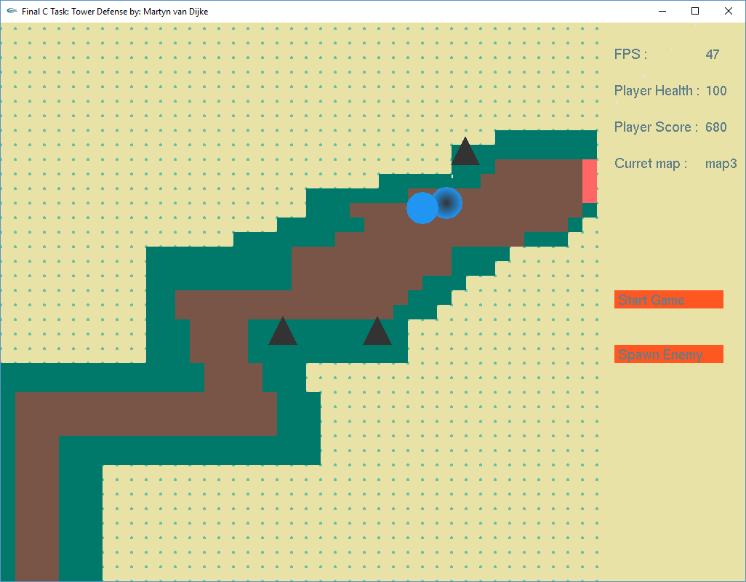
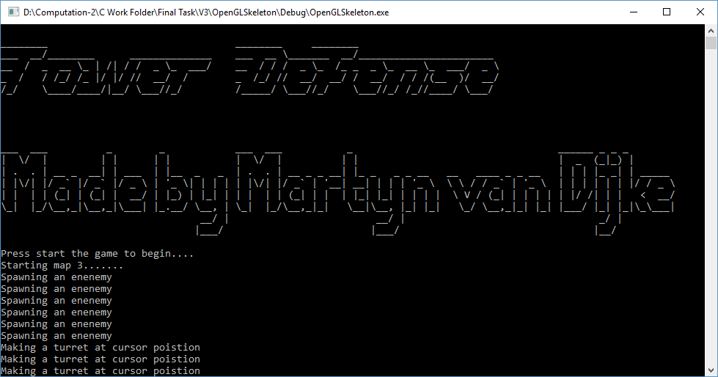
Basic
Turret aiming
Enemy movement
Map data where to build & walk
GUI
Debug & control
Overview of the game

Slide 5
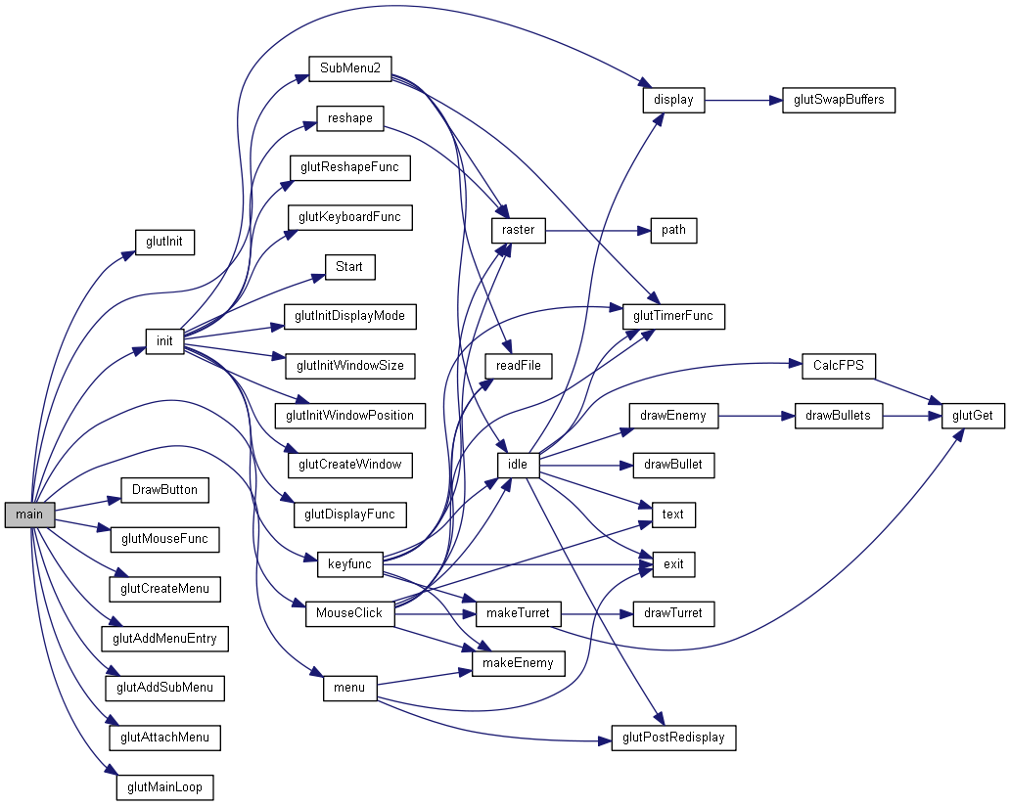
Overview of the
Main code :
Overview Code I Main
Notes:
In order to explain this mess of networks a look is made in the init function and the keyboard function along with the nececarry stops into classes etc

Slide 6
Number
Statictics

Slide 7
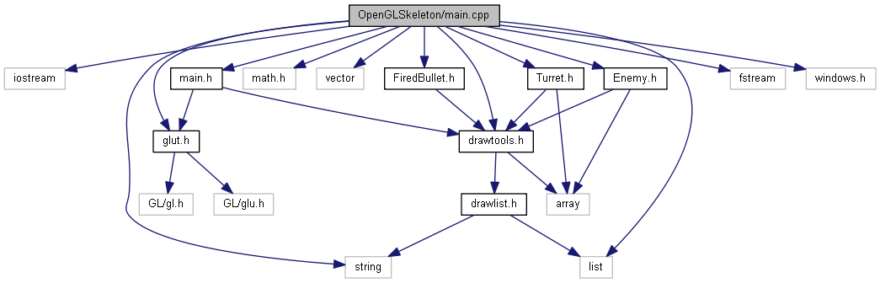
Important library includes
Vector use instead of (linked) list
Mat library for calculating (mostly circles and intersection points)
Fstream and iostream for file (map) access
Windows for waiting
Library includes

Slide 8
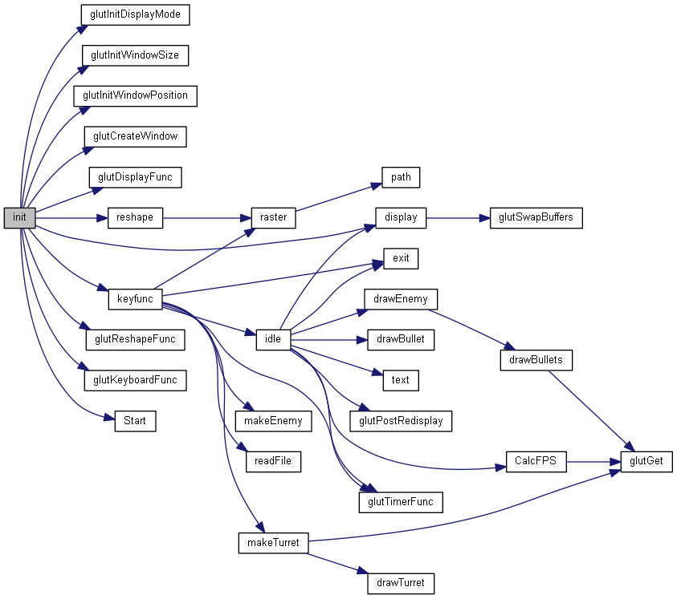
Init()

Slide 9
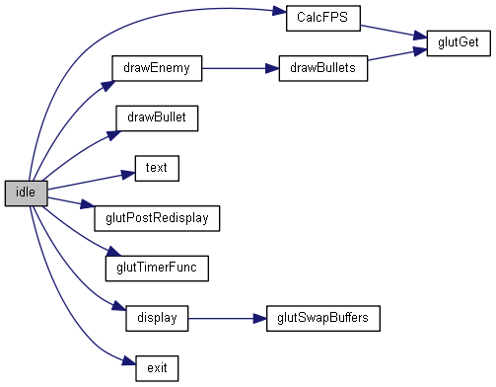
Idle()
Calculates all updates
Overview || Important functions

Slide 10
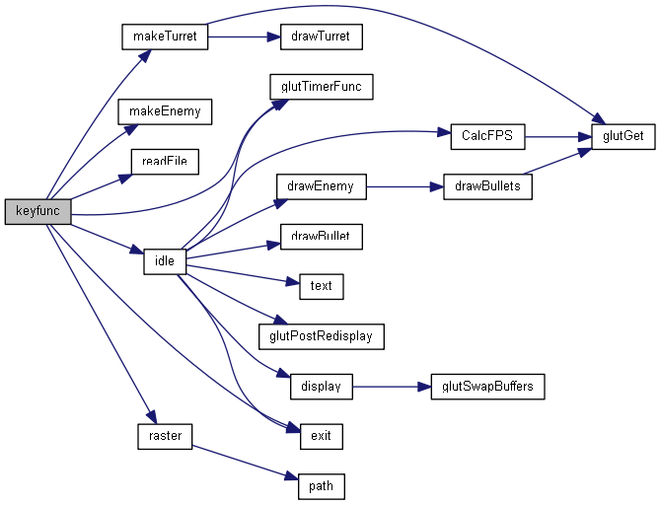
Keyfunc()

Slide 11
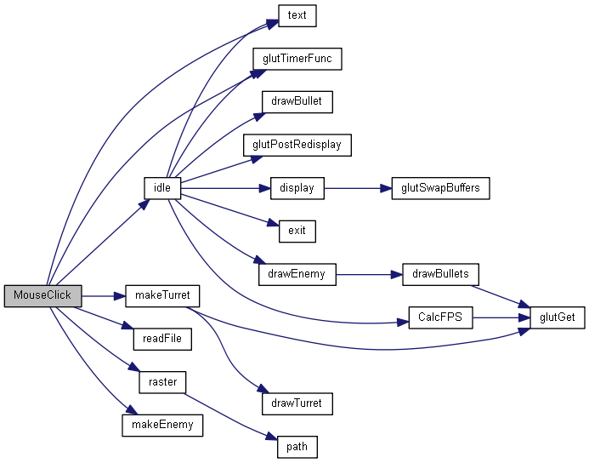
MouseClick()
Handels mouse input

Slide 12
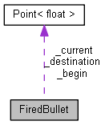
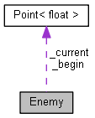
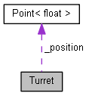
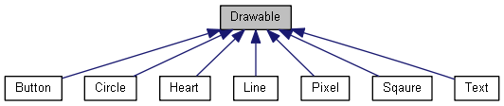
Classes
FiredBullet
Enemy
Turret
Drawable:
Button
Circle
Heart (future)
Line
Square
Text
Features

Slide 13
Extra features
Sound effects
Multiple maps
Button’s
Mouse input
Keyboard input
GLUT window input
Additional features

Slide 14
Improvements that can be made
Aim algorithm
More predictive aiming
Walk algorithm
Implement A*
Improvements to be made

Slide 15
Conclusion
Fun to program C++
C++ is very extensible and fast
C++ & GLUT can be cumbersome
Conclude

Slide 16

Are there any questions ?
Questions

Slide 17
Demo
Demo

